Slide 1


JUST BASH IT!

Slide 2



CENTER FOR HEALTH DATA SCIENCE (HEADS)
Data Lab Supports Researchers at the Faculty
Consultation & Commission:
Data science and bioinformatics analyses
Teaching: Courses & Workshops, Seminars.
Henrike Zschach
Thilde Terkelsen
XXXXXX XXXXXX
COPENHAGEN UNIVERSITY LIBRARY (KUB)
XXXXXX XXXXXX
XXXXXX XXXXXX
XXXXXX XXXXXX

Slide 3
JUST BASH IT!
PROGRAM
-
COURSE MATERIALS:
https://github.com/Center-for-Health-Data-Science/Just-Bash-It

Slide 4
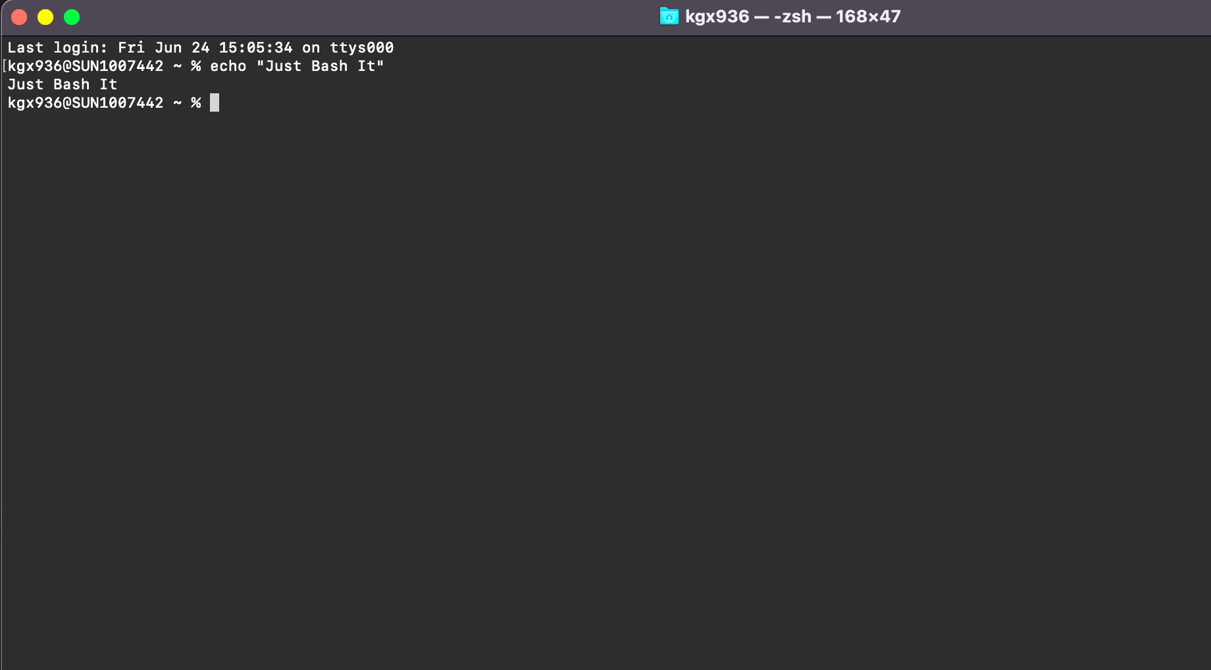
“
“What is a shell, a terminal, a command-line, and what is bash?”
“How do these concepts connected to my computer?”

Slide 5
TERMINOLOGY
COMPUTER (Hardware)
BASH SHELL -
COMMAND INTEPRETER
OPERATING SYSTEM (GUI)
$_
TERMINAL -
WRAPPER FOR SHELL
FILES SOFWARE
You open the terminal on your computer
You type bash commands
Commands are interpreted and feed to the OS
>
Notes:
Operating system may use a command-line interface (CLI) or graphical user interface (GUI).
Unix & Linux operating systems are CLI.
Windows, Mac OSX, Ubuntu, etc. are GUI.
Bash is a shell & command-line interpreter which interacts with the operating system on a computer.
Bash is may be used though a wrapper program which provides a text window, the terminal, where the user types commands which in terms cause actions on a computer.
Accesses runs softwares installed
File viewing & manipulation
The Bash shell is the default shell for the linux & unix operating systems. This is why you often hear these mentioned together, however most operating systems (also those with GUIs), contain a shell, where bash is the most popular.
Default on OSX and Ubuntu
Windows has a native windows shell as default, but a bash shell may easily be installed.

Slide 6
Wind
Flexible and works on any system
Automatised and Reproducible
SELL IT TO ME!
Benefits of bash & command line:
Do a lot with minimum effort on any system.
Reproducible, automated and parallelize your analysis.
Fast processes, less computationally intensive, no GUI.
Power to handle big data and heavy computations.
Handling Big Datasets
Not Resource Intensive
and Fast
HPC & Cloud Compute Power

Slide 7
A COUPLE OF EXAMPLES
1
2
3
REGISTRY DATA
SEQUENCING DATA
DATABASES
Drug adverse effects and mortality:
Person sensitive
Huge files, many columns
Different formats
Single Cell RNA from Cystic Fibrosis:
Paired-end sequencing
300 patients
Two fastq files per patient
Drug Databases - molecular structure & interaction:
Multiple large databases
Different formats
Maybe not downloadable

Slide 8
HOW DO I GET A BASH SHELL?
YEAH!
YOU HAVE A BASH SHELL & TERMINAL ALREADY.
Search for terminal on your laptop and open it.
YOU NEED TO INSTALL A BASH SHELL/TERMINAL:
MobaXterm: https://mobaxterm.mobatek.net/download.html
Cmder: https://cmder.net/
GOW (Cygwin): https://github.com/bmatzelle/gow
PuTTY: https://www.putty.org/
OS X or UBUNTU
WINDOWS
In this course Windows users will be working on MobaXterm.
You should have installed this shell via. instructions in the introduction email.

Slide 9
WHAT WILL I LEARN TODAY?
STORAGE,
BACKUP & MORE…
SCRIPTS &
AUTOMATIZATION
MORE BASH
COMMANDS
ORGANIZATION
& STRUCTURE
The BASICS
OF BASH
Version Control
Local vs remove
Conda & homebrew
Pipe, stdin, stdout
Loops & Scripts
Pipelines
Write files
Manipulate files
Search, cut, paste
Set up directories
Paths & Permission
Utility manager
The terminal
Navigation w. bash
Read, copy, move
1
2
3
4
5

Slide 10
NAVIGATING
FILES & DIRECTORIES

Slide 11
11
NAVIGATING FILES AND DIRECTORIES
Where am I on my computer? (And what does that mean?)
How can I move around on my computer?
What are files and directories?
How can I see what files and directories I have?
How can I specify the location of a file or directory on my computer?
YEAH!
YOU HAVE A BASH SHELL & TERMINAL ALREADY.

Slide 12
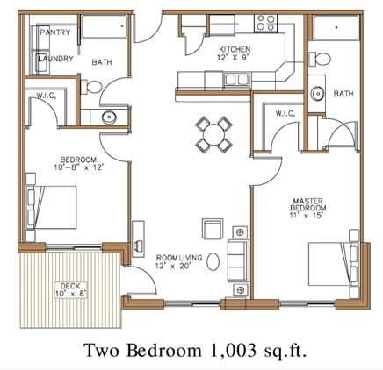
12
THE DIRECTORY TREE
Your computer is like a house:
It has different rooms, i.e. directories which contain items, i.e. files.
You cannot be in two different rooms at the same time.
Your files are items in the house and they are in specific places. Your bed is in your bedroom.
In order to interact with your item you need to know where it is.
You can move items from one room to another.
YEAH!
YOU HAVE A BASH SHELL & TERMINAL ALREADY.

Slide 13
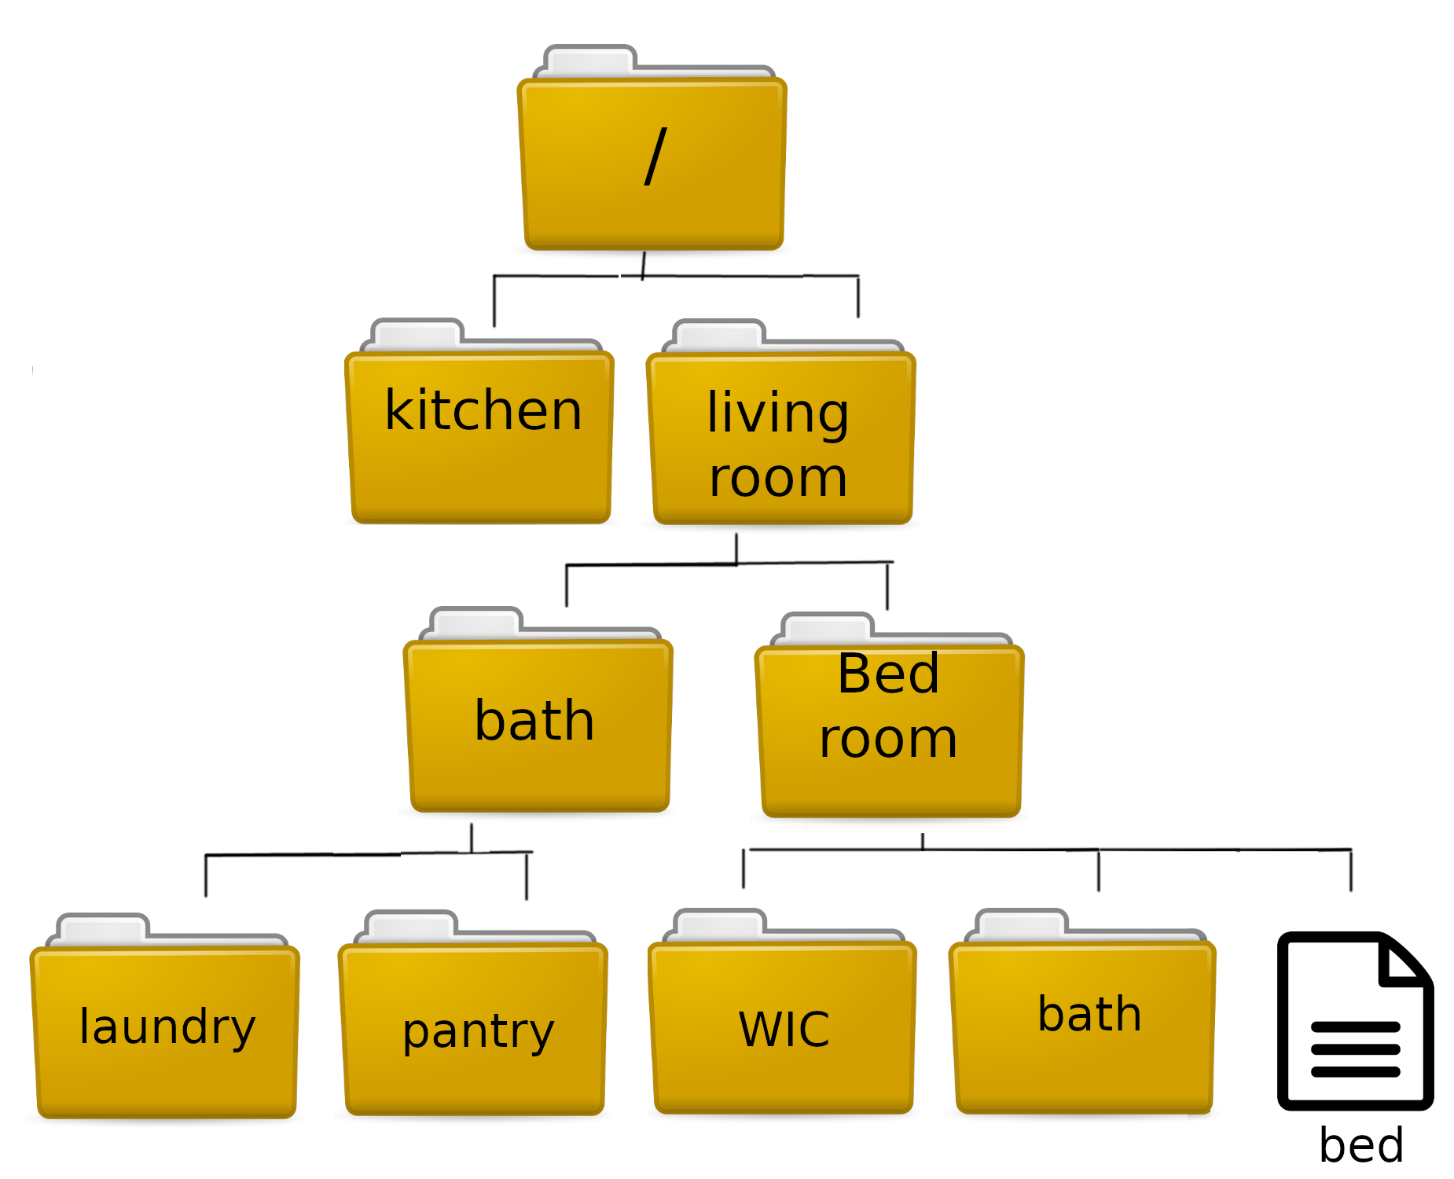
13
THE DIRECTORY TREE
A loose translation of the floor plan into a directory tree:
YEAH!
YOU HAVE A BASH SHELL & TERMINAL ALREADY.
The directory tree is hierarchical and starts at the ‘root’ = ‘/’

Slide 14
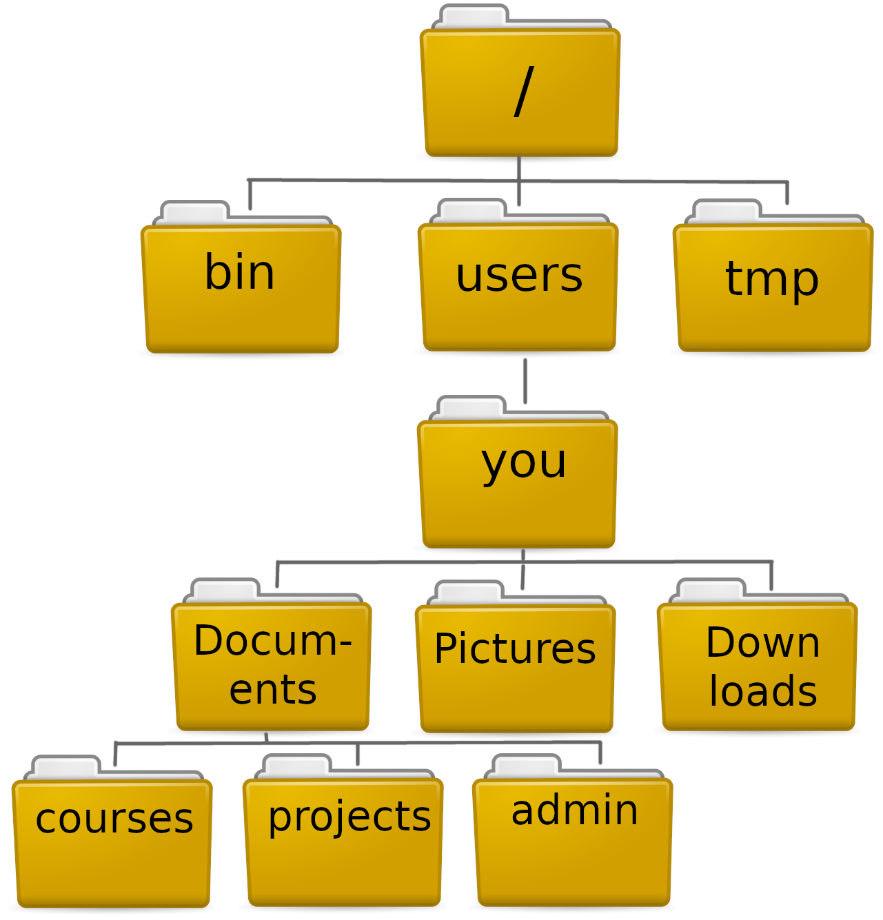
14
THE HOME DIRECTORY
When you open your terminal you will be in your home directory.
The directory you are currently located at is called your working directory and you can check it with:
$ pwd
Open your terminal and check where you are.
(Depending on your system the structure might be bit different from the illustration.)
You home directory is also represented by the symbol '~'. You might notice this symbol later when looking at your current directory or changing into a directory.
= ‘~’

Slide 15
15
LISTING CONTENT
To list all contents of a directory, including other directories, use the command
$ ls
Without any arguments, ls will list what is in your current working directory. You can also list other directories by specifying the path to them (we'll talk about paths in a bit):
$ ls /home/Users/
ls also many useful options such as –l, -t and –h, -F. Try it out!

Slide 16
16
CHANGING DIRECTORIES
From your working directory, you can easily move into any subdirectory:
$ cd Documents
You can also move several directories down:
$ cd Documents/courses
To move 'up' on the directory tree you need to use the syntax '../' . Each time you write this, you go one level up.
$ cd ../tmp
'cd' without any arguments brings you back to your home directory. Try it out!

Slide 17
17
PATHS
Each file and directory exist in one specific place on your computer. One could say they have an address.
This ‘address’ is called their path. It is an instructions how to find the file or directory.
Following the example from earlier, the path to you bed would be:
/entrance/living_room/Bedroom/bed.txt

Slide 18
18
PATHS
Paths can be full/absolute or relative.
Full paths always start at the root. Since ~ represent the path to your home directory it naturally includes the root. So
/home/user/[you]/Documents
And
~/Documents
Are the same place and the same path.
Full paths are always unambiguous since they describe the entire 'journey' starting from the root.

Slide 19
19
PATHS
Relative paths are an address relative to the current working directory. If my working directory is ‘Documents’, I can address this presentation as:
courses/Just-Bash-It-main/Commandline_Workshop.pptx
Relative paths can include going up the directory tree:
../Pictures/summer2022/Bornholm
This kind of notation does not make sense for full paths since they start from the root and go strictly downwards.

Slide 20
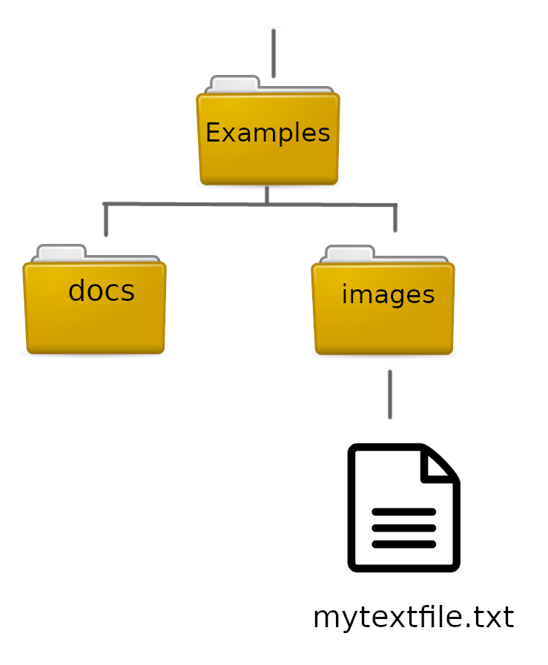

20
MOVING FILES AND DIRS
For this part, lets go into the 'Examples' folder of the github repo.
You can move files (and directories) from one place into another with mv:
$ mv mytextfile.txt ../docs
mv can also be used for renaming:
$ mv mytextfile.txt my_text_file.txt
A note of caution: Do not try to move or remove your home directory or other system critical dirs. This may have unintended consequences.

Slide 21
21
COPY AND REMOVE
Files can also be duplicated with the 'cp' command:
$ cp my_text_file.txt text_copy.txt
To copy a directory (and all its contents!) you need to use the –r flag
To remove files and dirs, use 'rm'
$ rm text_copy.txt
Caution: Unlike in many graphical file managers, rm is permanent. You cannot recover a removed file (unless from back up) and you will not be prompted on whether you are sure you want it gone.

Slide 22
22
COMMANDS
We interact with the computer by issuing commands to it. You have already tried some like 'cd', 'ls', 'pwd'.
Some commands can stand by themselves like 'pwd', but often they have arguments and options/flags:
$ ls –lh ~/Documents/courses
The command:
List contents
The options/ flags:
Long format &
Human-readable size
The argument:
Path to the directory to work on

Slide 23
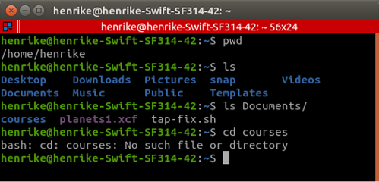
23
WHEN THINGS GO WRONG
Assuming I am in my home directory and I write:
$ cd courses
What will happen?

Slide 24
24
WHEN THINGS GO WRONG
1
Don’t panic!
2
Read the error message
3
Try to correct your error
4
If lost, google or read the help page

Slide 25
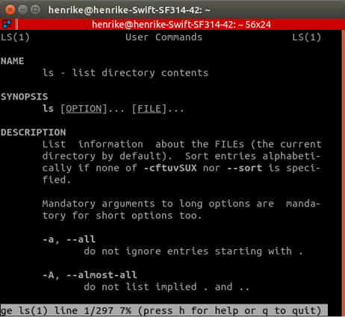
25
GETTING HELP
Many commands have a built-in help page, also called the manual. You can usually call it with ‘man’. I.e. :
$ man ls
The man page is useful because it includes:
A description of what the command does
Explanation for arguments
Usage examples (the syntax of the command, what goes where)
Commands that do not have a man page might have a help you can call with the option (-)-help or --h .

Slide 26
CHEAT SHEET 1
MOVING AROUND
WHAT'S HERE
ls # list all files/dirs in current dir
man [cmd] # open manual for command
[cmd] --help # view the help for command
pwd # print working dir
cd # go to home dir
cd [path] # change to (path) dir
cd .. # go one level up

Slide 27
PROJECT
ORGANIZATION
& BACKUP

Slide 28

IS YOUR COMPUTER A LAUNDRY BASKET?
Why should I care about directory structure and file naming?
Not nice to not “work” in a mess.
If your computer crashes it is MUCH easier to recover work if files/directories are structured.
If you apply a command (bash, R, Python) to a group of files/directories, naming is important!
Large files should be stored smartly to save space.

Slide 29
DO’S and DON’TS
Consistent and Logical Directory Structure and Naming
Don’t Use Symbols or Spaces in File/Directory Names
Consistant & Non-
redundant File Naming
Don’t store multiple copies of file, instead point to it (path).
Version Control System
git/GitHub & Back-up
Don’t Store Large Data/Files on Your Local Computer
Clean and Update Your Computer Regularly
Don’t Store Sensitive Datasets on Your Computer

Slide 30
A SUGGESTION FOR STRUCTURE
HOME
USER
DRIVE
PROJECTS
NAME
RESULTS
SCRIPTS
DATA
SCRATCH
DOCX
TABLES
FIGURES
RAW
GENERATED
LITERATURE
DRAFTS

Slide 31
BACKUP
BIG DATA & SENSITIVE DATA:
Your own KU drives (S-drive)
ERDA & SIF (KU data storage)
Lab or department server
Lab or department cloud solution
SCRIPTS, MARKDOWNS:
git/GitHub
(KU drives)
DOCX, EXCEL, POWERPOINT:
Google Drive
Dropbox
(KU drives)
LARGE DATASETS
SENSITIVE DATA
DOCUMENTS & GRAPHICS
SCRIPTS REPORTS

Slide 32


GIT & GITHUB
Git is a version control software, created by Linus Torvalds for the management of the Linux kernel.
Other clients exist.
https://git-scm.com
GitHub is a web-based hosting service for version control that uses git
Other services exist.
https://github.com
git & GItHub not the same

Slide 33
WHAT IS A VERSION CONTROL SYSTEM?
VERSION 3
VERSION 2
FILE
FILE
GIT
VERSION 1
GIT
VERSION 3
VERSION DATABASE
VERSION 3
VERSION 2
GITHUB
VERSION 2
VERSION 1
VERSION 1
VERSION DATABASE
VERSION DATABASE
YOUR COMPUTER
COLLABORATOR

Slide 34

GIT WORKS FROM THE COMMAND LINE
git clone [your repository]
Username: [your user]
Password: [your password]
Git is used from the command line to edit directories & files in a version controlled way
A git command always begins with git
git status (status of the repo)
git add (add new files or changes)
git commit -m (commit the changes)
git push (push the changes to GitHub)
Git enables a local computer to interact with a cloud service (GitHub) to back up your work
Sounds cool, yes!
Take our ‘Introduction to git & GitHub’ Workshop and learn how to git

Slide 35
A SUGGESTION FOR STRUCTURE
LOCAL COMPUTER
EXTERNAL BACKUP
HOME
CLOUD
USER
DRIVE
GITHUB
PROJECTS
DRIVE
NAME
README
RESULTS
SCRIPTS
DATA
SCRATCH
DOCX
TABLES
FIGURES
RAW
GENERATED
LITERATURE
DRAFTS

Slide 36
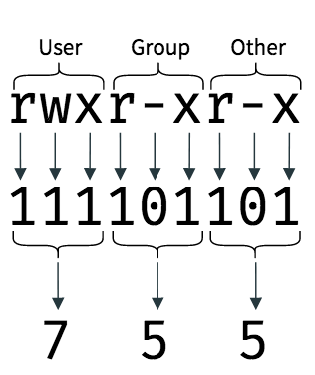
USERS, GROUPS & PERMISSIONS
Files & directories have permission settings
Permissions denote who can read, write (edit) and execute a file/dir
Permissions can be changed IF your are a system administrator (sys admin).
Private computer : You are sys admin
KU computer : You may be the system admin
Shared KU drives : You are not sys admin
HPCs, Servers & Clouds : You are not sys admin
chmod +rwx [filename]
chmod -wx [directoryname]

Slide 37
CHEAT SHEET 1
WHERE & WHAT
FILE/DIR BASICS
touch [name] # make a file
mkdir [name] # make a dir
rm (-r) [name] # remove a file or dir
cp [name] # copy a file/dir
mv [name] [path] # move file/dir
pwd # print working dir
cd [path] # change dir (remember path)
ls # list dir content
man [command] # get info about command
SPECIAL CHARACTERS
SIZE & PERMISSION
* # select everything
/ # forward slash paths
\ # escape character (don’t use for now)
.. # one dir up/back
. # current dir
- # denotes a flag/argument
ls -lh * # all sizes
ls -lh [name] # file/dir size
du -sh # total size
chmod +rwx [name] # add a permission
chmod -rwx [name] # remove a permission

Slide 38
WORKING WITH FILES AND DIRECTORIES

Slide 39
VIEWING FILES
Many roads lead to Rome… For viewing files we can use:
less [file]:
Prints N first lines of file. You can change the default N. Interactive viewing.
Exit with q
cat [file]:
(concatenation), prints all lines of file. Interactive viewing.
Exit with ctrl + c
head/tail [file]:
Prints N first lines of file. You can change the default N. Static viewing.
less
cat
tail
head
FILE CONTENT

Slide 40
EDITING FILES
ano
Nano [file]:
Simple and easy to use
Limited functionality
Exit with Ctrl + x (Y + enter)
VIM [file]:
Many functionalities, i.e. complex
Keyboard shortcuts
Exit with :q (:w or :q!)
EMACS [file]:
Oldest editor
Keyboard shortcuts, Ctrl, Alt/Esc + [L]
Exit with Ctrl + x (Ctrl + s)
OTHER [file]:
There are many other editors …
IM
Q: What is an editor?
A: Software that allows you to edit a file
macs
OTHER

Slide 41

COMPRESSED FILES
.GZ
Standard gzip (GNU zip) compression.
May contain multiple files & directories
gunzip -k [file.gz]
gzip -dk [file.gz]
tar -xvf [file.tar.gz]
.TAR
An archive of multiple files put together inside a single file.
.TAR.GZ
A compressed archive of multiple files put together inside a single file.

Slide 42
ADVANCED COMMANDS
- MORE BASH

Slide 43
THILDE
YEAH!
YOU HAVE A BASH SHELL & TERMINAL ALREADY.

Slide 44
REDIRECTION & PIPES

Slide 45
45
A TALE OF THREE STREAMS
stdin
Data in unix always moves along one of three (data) streams:
Keyboard
Program
YEAH!
YOU HAVE A BASH SHELL & TERMINAL ALREADY.
stdin (Standard In) – the stream along which input to commands moves
stdout (Standard out) - the output of commands moves along this stream
stderr (Standard error) – error messages move via this stream
stderr
Program
Display
stdout
Each of the streams can be redirected separately.

Slide 46
46
A TALE OF THREE STREAMS
stdout (Standard out) - the output of commands moves along this stream
stderr (Standard error) – error messages move via this stream
By default stdout points to the display, your terminal window
ls *
stderr
Program
BashFigure1.jpeg
Commandline_Workshop.pptx
Data
Examples
Just_Bash_It_Exercises.md
Just_Bash_It_Exercises.Rmd
Just_Bash_It_Presentations.md
Just_Bash_It_Presentations.Rmd
LICENSE
README.md
Display
stdout
Your
terminal

Slide 47
47
A TALE OF THREE STREAMS
Redirect stdout:
$ ls > list_results.txt
Redirect stderr:
$ ls 2> err.txt
Redirect both into different files:
$ ls 2> err.txt > list_results.txt
Redirect both into the same file:
$ ls &> both
But stdout and stderr can be redirected to i.e. a file:
ls *
stderr
Program
'2>' will redirect stderr.
'>'
Display
File
stdout
Your
terminal

Slide 48
48
A TALE OF THREE STREAMS
Many commands require input data to work on, i.e. wc works on a file.
stdin
Keyboard
Program
YEAH!
YOU HAVE A BASH SHELL & TERMINAL ALREADY.
Usually input data comes from the keyboard, i.e. the name of the file to word count.
But it can also come directly from another program!
stderr
Program
Display
stdout

Slide 49

CHAINING COMMANDS
file1.txt
$ wc *.txt > file_lengths
YEAH!
YOU HAVE A BASH SHELL & TERMINAL ALREADY.
wc *
file2.txt
file3.txt
$ sort –n file_lengths
File1.txt 10
File2.txt 5
File3.txt 8
But now we have an intermediate file we don't need.
sort

Slide 50
50
CHAINING COMMANDS
wc *
sort -n
List of files and their number of words
Sorted list of files and their number of words
$ wc *.txt | sort -n
stdout
stdin
stdout
Pipe
Pipe
Display

Slide 51
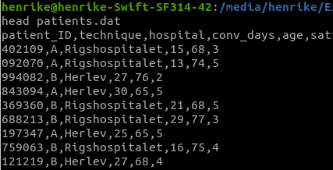
51
CHAINING COMMANDS
Some examples:
Take the second column and count how often each element occurs:
$ cut –d ',' –f 2 patients.dat | sort | uniq –c
Get only lines containing 'Herlev' and sort by age:
$ grep 'Herlev' | sort –n –k 5 –t ','
If we don’t want the entire line we could also cut out the age column before sorting:
$ grep 'Herlev' | cut –f 5 –d ',' | sort -n

Slide 52
SHELL SCRIPTS

Slide 53
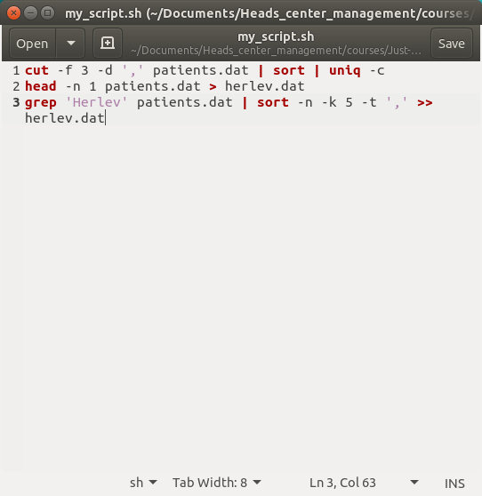
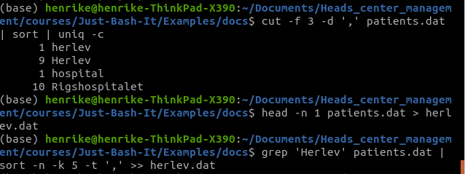
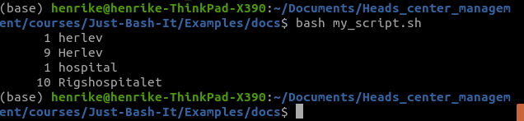
53
WRITING SCRIPTS
Save your commands for later use!
Re-run anytime, always same result
You can check your script if you don't remember what analysis you did
Don't lose your work: Back-up your scripts on i.e. github, KU drive, ect

Slide 54
54
COMMANDLINE INPUT
# this is a comment line
# usage: sort_this.sh file_name
sort $1 –n
You can add arguments when you call your script which will be passed to it.
This is useful if you want to i.e. specify the file you want to run the script on.
The first argument after the script name will be $1 inside the script. The second one will be $2 and so on.
$ bash sort_this.sh patients.dat
$ bash sort_this.sh my_textfile.txt
# usage: cut_col file_name column_number
cut –d ',' –f $2 $1
$ bash cut_col patients.dat 3

Slide 55
SOFTWARE INSTALLATION UPKEEP & MORE

Slide 56
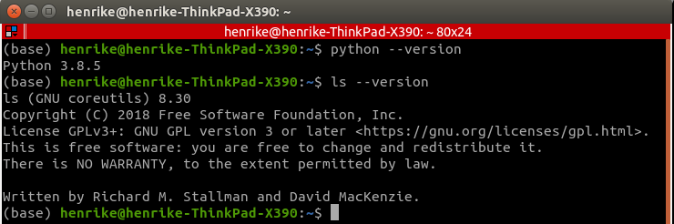
56
CHECKING THE VERSION
You can generally check the version of installed software with --version:

Slide 57
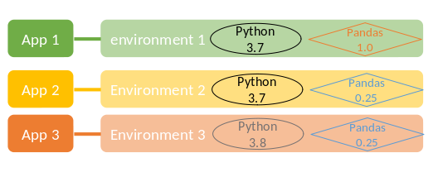

57
CONDA
Conda is an open source package and environment management system.
Many softwares exist as conda packages, which means you can use conda to install them and it will take care of dependencies. Sometimes a conda install is the only one that works.
An environment is a specific combination of packages in a specific version. As long as you do not update the packages, running an analysis in the same environment will always give the same result. You can also share your environments via config files.

Slide 58
58
KEEPING UP TO DATE
Generally, you update your software with the same tool you used to install it:
Installed with apt-get:
apt-get update && apt-get dist-upgrade
Installed with conda:
conda update –all (updates only the currently active environment)
Installed with Windows App store:
Update via Windows App store
Installed with homebrew: brew upgrade python3

Slide 59
BOTH
YEAH!
YOU HAVE A BASH SHELL & TERMINAL ALREADY.

Slide 60
LOOPS & WORKFLOW LANGUAGE

Slide 61
61
LOOPS IN BASH
#example of a for loop in bash
for file in *.txt
do
echo $file
wc $file
done
#the general syntax of a for loop is:
for [iterator] in [generator]
do
commands
done
Loops allow you to repeat the same action several times, once for each file for example.
Many bash commands already run on several files, i.e.
$ wc *.txt
However, a loop is useful if you want to execute several commands for each file.

Slide 62
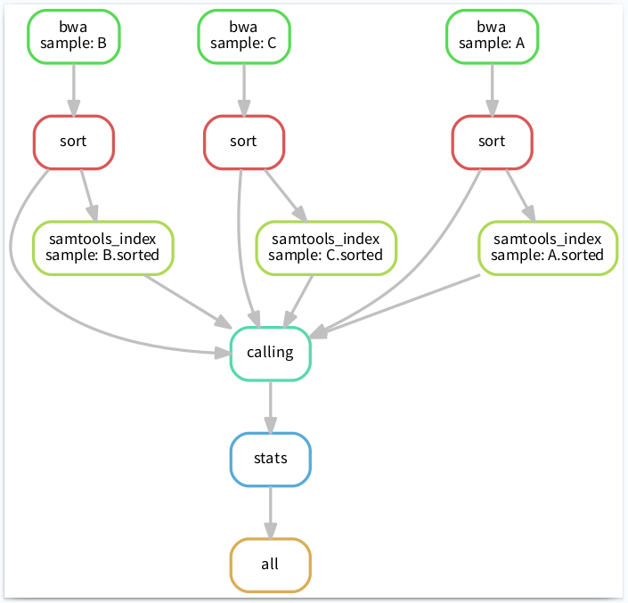


62
WORKFLOW LANGUAGES
Workflow languages are a specialized tool to create pipelines that are more robust than simple bash scripts.
Workflow languages allow you to control the flow of your pipeline, enable you to restart at various defined points, ensure previous commands have executed without error and take care of logging.
snakemake nextflow

